Slide 1
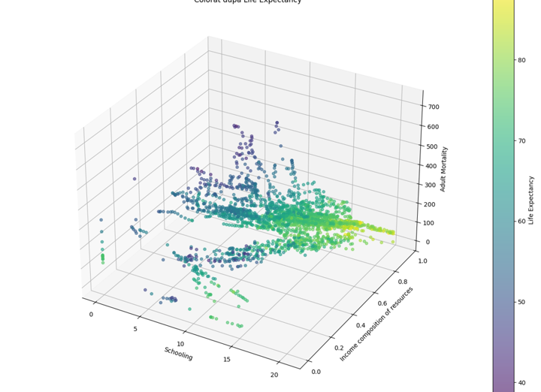
Dincolo de Cifre: Analiza Predictiva a Longevitatii Globale
Utilizarea Machine Learning (XGBoost & MLP) pentru modelarea Sperantei de Viata (serii anuale 2000-2015).

Slide 2
Obiectivele Proiectului
Misiunea: Transformarea datelor brute in informatii de impact.
Identificarea factorilor de risc critici la nivel global.
Dezvoltarea unui model de prognoza robust (R² > 0.85).
Analiza impactului socio-economic asupra sanatatii publice.

Slide 3
Arhitectura Datelor si Pipeline
Sursa Date: Serii anuale globale (2000-2015), acoperind peste 160 de tari.
Rafinare (Data Cleaning): Eliminarea a 330 randuri cu date lipsa critice.
Engineering: Imput bazat pe media setului de antrenament.
Normalizare: Corectii de scala pentru indicatorii GDP si Populatie, adaugare zerouri/valori mediene pentru anumite valori nule.

Slide 4
Metodologie si Optimizare Model
Algoritmi: Comparare intre Gradient Boosting (XGBoost) si MLP (Keras).
Optimizare: Random Search (30 combinatii) & Early Stopping.
Transformari: Log-transformari pentru variabile asimetrice (Mortalitate).
Validare: Split temporal riguros (Train/Validare/Test).

Slide 5
Rezultate: Precizie si Fiabilitate
Indicator R²: 0.925 (Modelul explica 92.5% din variatia datelor).
MAE (Eroare Medie Absoluta): 1.48 ani.
Fiabilitate Practica: 76.8% din predictii au o eroare sub ±2 ani.
Stabilitate: Performanta constanta pe setul de testare independent.

Slide 6
Insights: Factorii Determinanti
1. HIV/AIDS: Impact negativ major asupra longevitatii.
2. Mortalitatea Adulti: Cel mai puternic corelat predictor negativ.
3. Educatia (Schooling): Factor social determinant cu impact pe termen lung.
4. Resurse Economice: Venitul compozit ca motor esential al accesului la sanatate.

Slide 7
Lectii: Gestionarea Outlierilor
Provocare: Modelele MLP tindeau sa extrapoleze gresit pe extreme (ex: China).
Lipsa datelor pentru anumite coloane: e.g. hepatita B
Observatie: XGBoost ofera o stabilitate superioara pentru valori atipice.
Concluzie Tehnica: utilizare XGBoost si random search (optional utilizarea RobustScaler si Log-Transforms)

Slide 8
Concluzii si Directii Strategice
Model Robust: Pregatit pentru simulari de politici publice si prognoza.
Recomandare: Investitia in educatie are randament predictibil ridicat.
De urmarit: Integrarea factorilor de mediu si a indicatorilor de poluare.
Impact: Un instrument util pentru organizatiile internationale de sanatate.

Slide 9
Business Logic
Obiectiv: Predictia indicatorului 'Life Expectancy' la nivel global.
Utilitate: Sprijinirea politicilor de sanatate publica prin identificarea factorilor de risc.
Metodologie: Analiza predictiva pe date istorice (serii anuale, 2000-2015)
-clustering
-modele Keras MLP, XBOOST cu si fara random ssearch
-functii: leakyrelu vs relu
Factori urmariti: Mortalitate, Vaccinare, Indicatori Economici (PIB), Educatie.

Slide 10
Curatarea si Pregatirea Datelor
Randuri initiale: 2938
Randuri eliminate: 330 (tari cu date lipsa critice).
Split Temporal: Train (2000-2009), Validare (2010-2011), Test (2012-2015).
Imputare: Media pe setul de antrenament (evitarea data leakage).

Slide 11
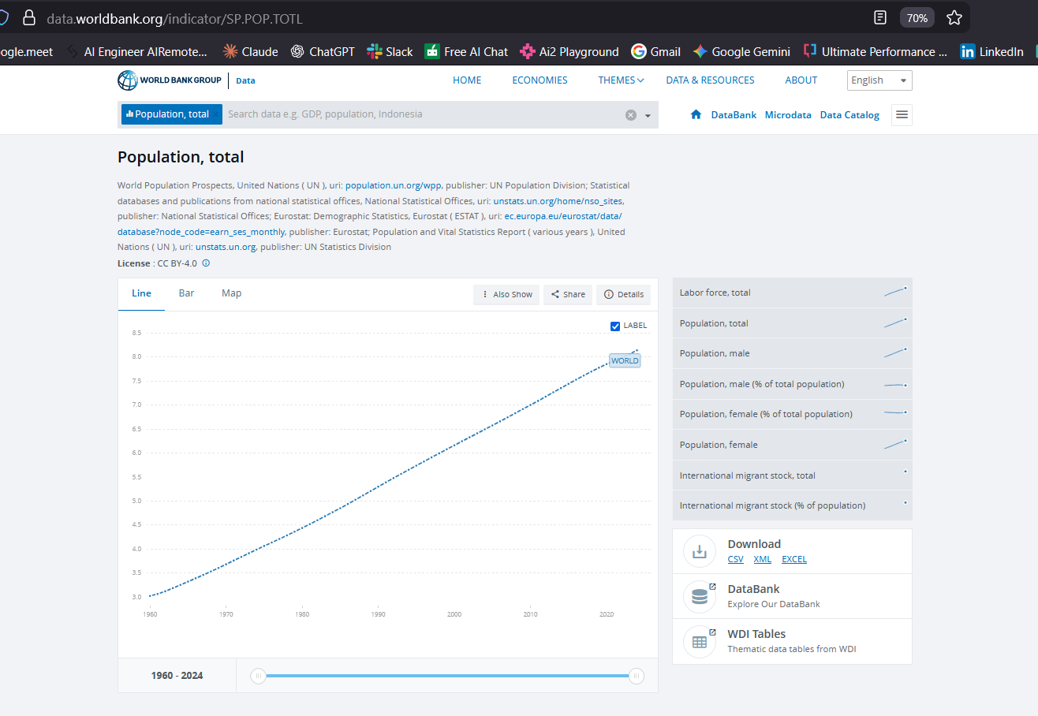
Curatarea si Pregatirea Datelor
Corectatarea si completare Coloane [GDP], [Population]

Slide 12
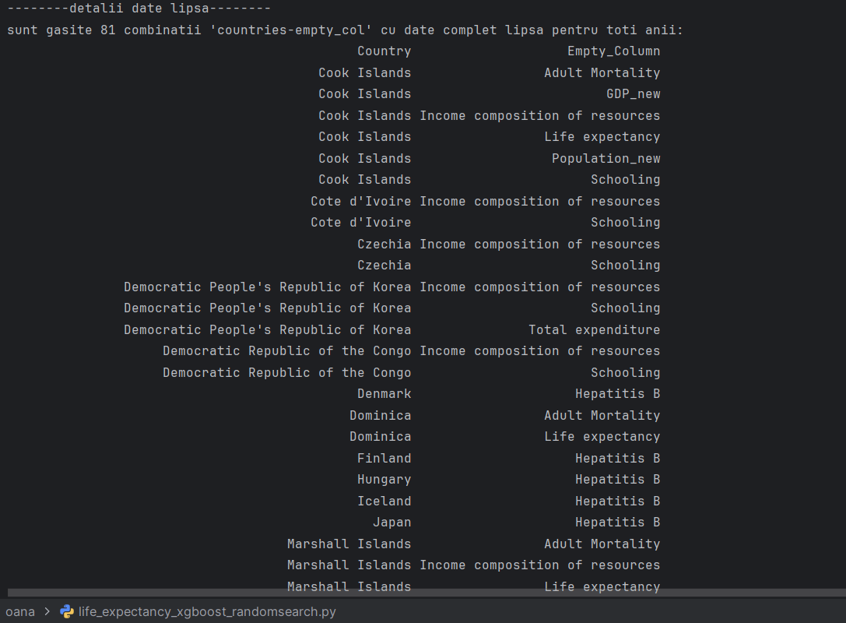
Modelul XGBoost si Random Search
Algoritm: XGBoost (Gradient Boosting nativ).
Optimizare: Random Search (30 combinatii de parametri).
Early Stopping: Prevenirea overfitting-ului (50 runde).
Hiperparametri: Learning rate (eta), Adancime (max_depth), Subsample, Regularizare (Alpha/Lambda).

Slide 13
Curatarea si Pregatirea Datelor
-----countries unice afectate -----------
Numar countries afectate: 30
- Cook Islands
- Cote d'Ivoire
- Czechia
- DP Republic of Korea
- Democratic Republic of the Congo
- Denmark
- Dominica
- Finland
- Hungary
- Iceland
- Japan
- Marshall Islands
- Monaco
- Nauru
- Niue
- Norway
- Palau
- Republic of Korea
- Republic of Moldova
- Saint Kitts and Nevis
- San Marino
- Slovenia
- Somalia
- South Sudan
- Sudan
- Switzerland
- Tuvalu
- United Kingdom of Great Britain and Northern Ireland
- United Republic of Tanzania
- United States of America

Slide 14
Curatarea si Pregatirea Datelor
-------------data cleaned info()---------------
<class 'pandas.core.frame.DataFrame'>
Index: 2608 entries, 0 to 2937
Data columns (total 22 columns):
# Column Non-Null Count Dtype
--- ------ -------------- -----
0 Country 2608 non-null object
1 Year 2608 non-null int64
2 Status 2608 non-null object
3 Life expectancy 2608 non-null float64
4 Adult Mortality 2608 non-null float64
5 infant deaths 2608 non-null int64
6 Alcohol 2448 non-null float64
7 percentage expenditure 2608 non-null float64
8 Hepatitis B 2247 non-null float64
9 Measles 2608 non-null int64
10 BMI 2608 non-null float64
11 under-five deaths 2608 non-null int64
12 Polio 2600 non-null float64
13 Total expenditure 2444 non-null float64
14 Diphtheria 2600 non-null float64
15 HIV/AIDS 2608 non-null float64
16 GDP_new 2608 non-null float64
17 Population_new 2608 non-null float64
18 thinness 1-19 years 2608 non-null float64
19 thinness 5-9 years 2608 non-null float64
20 Income composition of resources 2608 non-null float64
21 Schooling 2608 non-null float64
dtypes: float64(16), int64(4), object(2)
memory usage: 468.6+ K

Slide 15
Curatarea si Pregatirea Datelor
---------rezultate curatare data frame---------
-numar initial de randuri: 2938
-numar randuri sterse: 330
-numar de randuri ramase: 2608
-numar initial de countries: 193
-numar countries sterse: 30
-numar countries unice ramase: 163
---------coloane ramase cu randuri nule dupa curatare data frame---------
Alcohol 160
Hepatitis B 361
Polio 8
Total expenditure 164
Diphtheria 8
dtype: int64

Slide 16
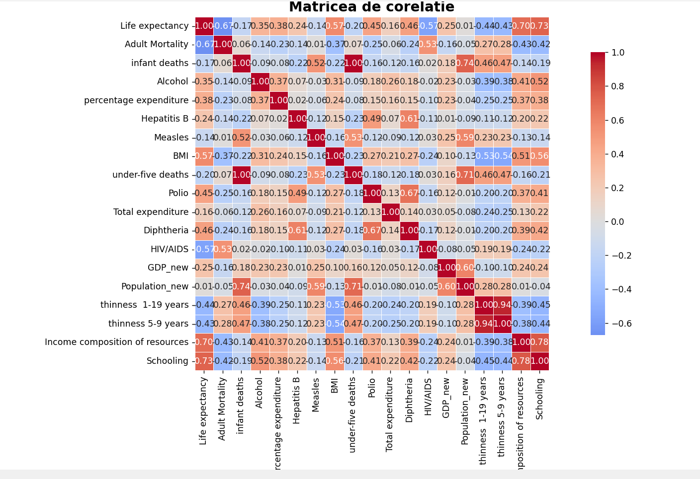
Analiza Datelor

Slide 17
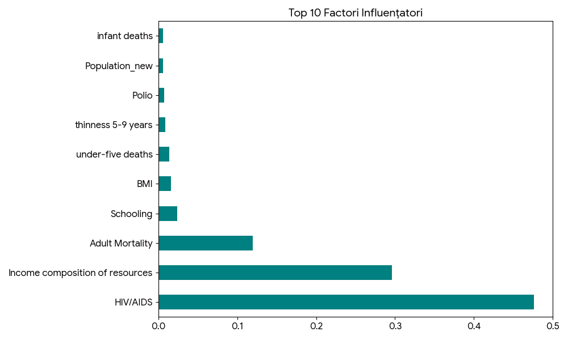
Analiza Factorilor de Influenta
HIV/AIDS: Impact major negativ asupra longevitatii.
Mortalitate Adulti: Corelatie directa puternica.
Resurse (Income composition): Indicator economic cheie.
Educatie (Schooling): Factor social determinant.

Slide 18
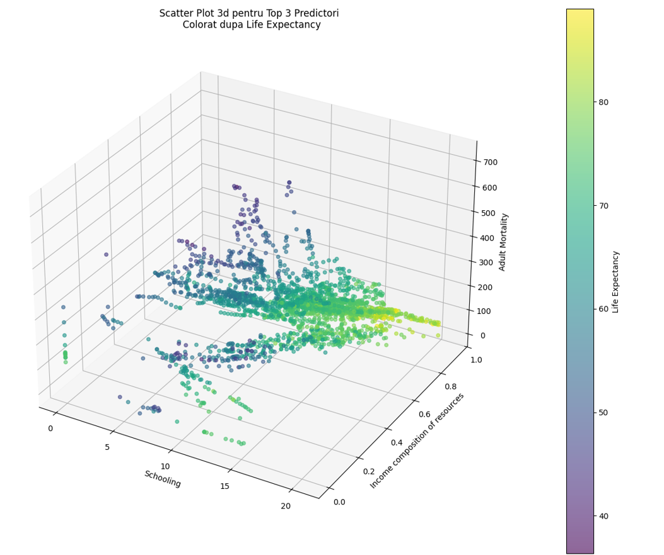
Analiza Datelor

Slide 19
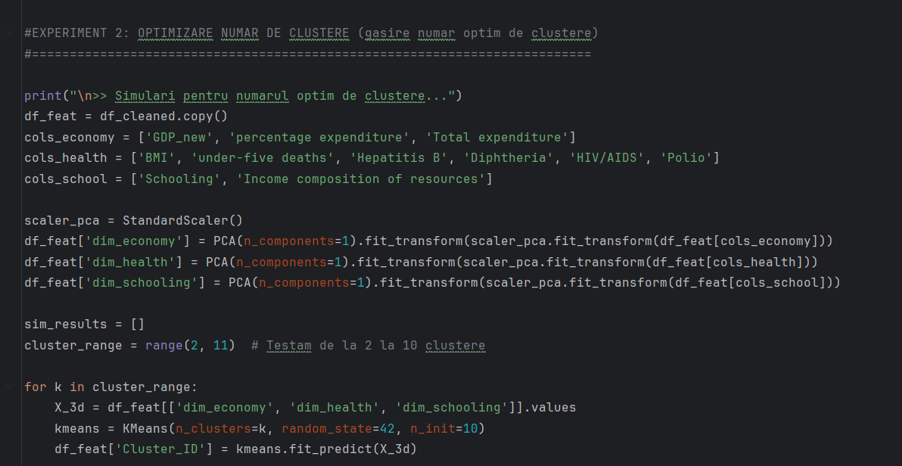
Clustering
Clustering > scop
- Optimizarea numarului de clustere utilizare in cadrul modelului, pentru a imbunatati performata predictiilor

Slide 20
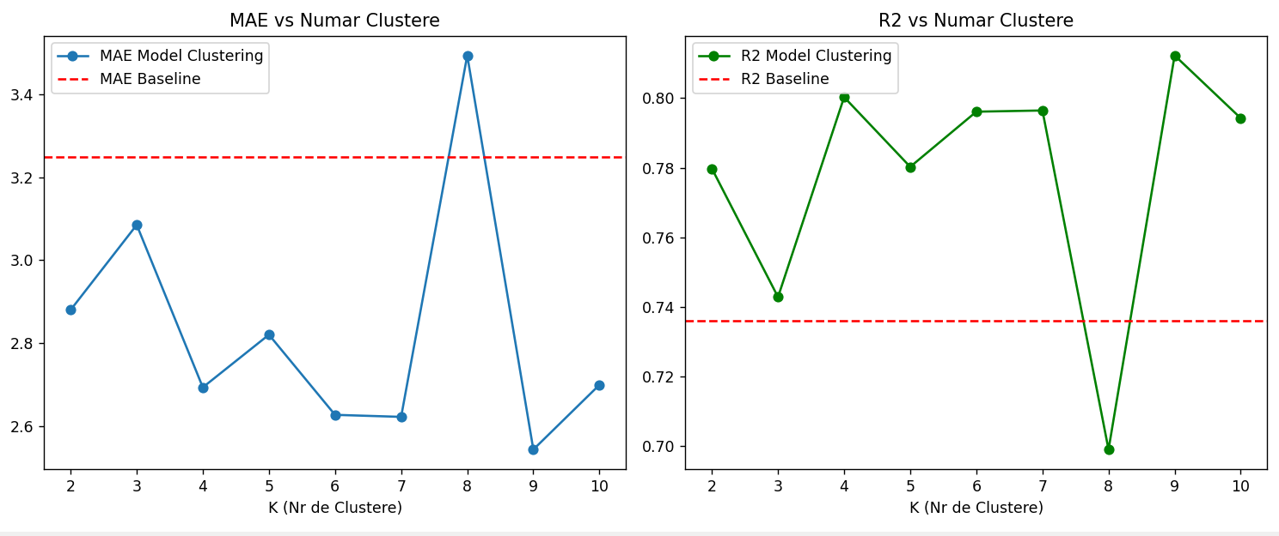
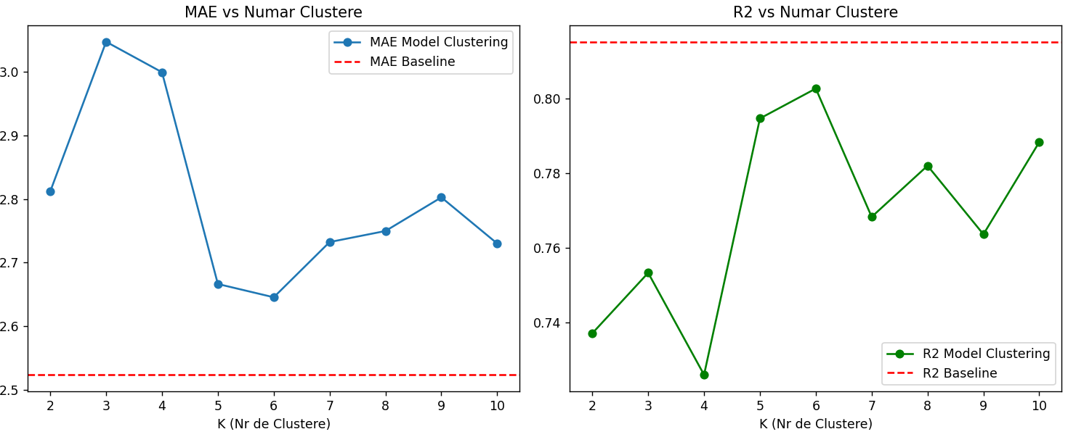
Clustering

Slide 21
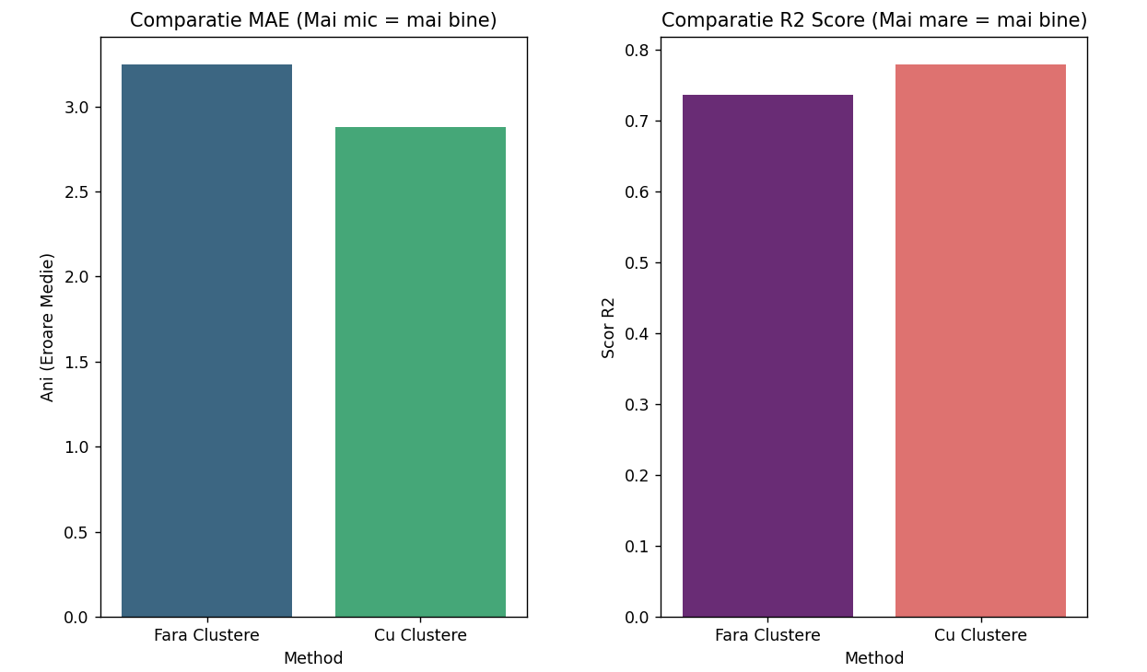
Clustering

Slide 22
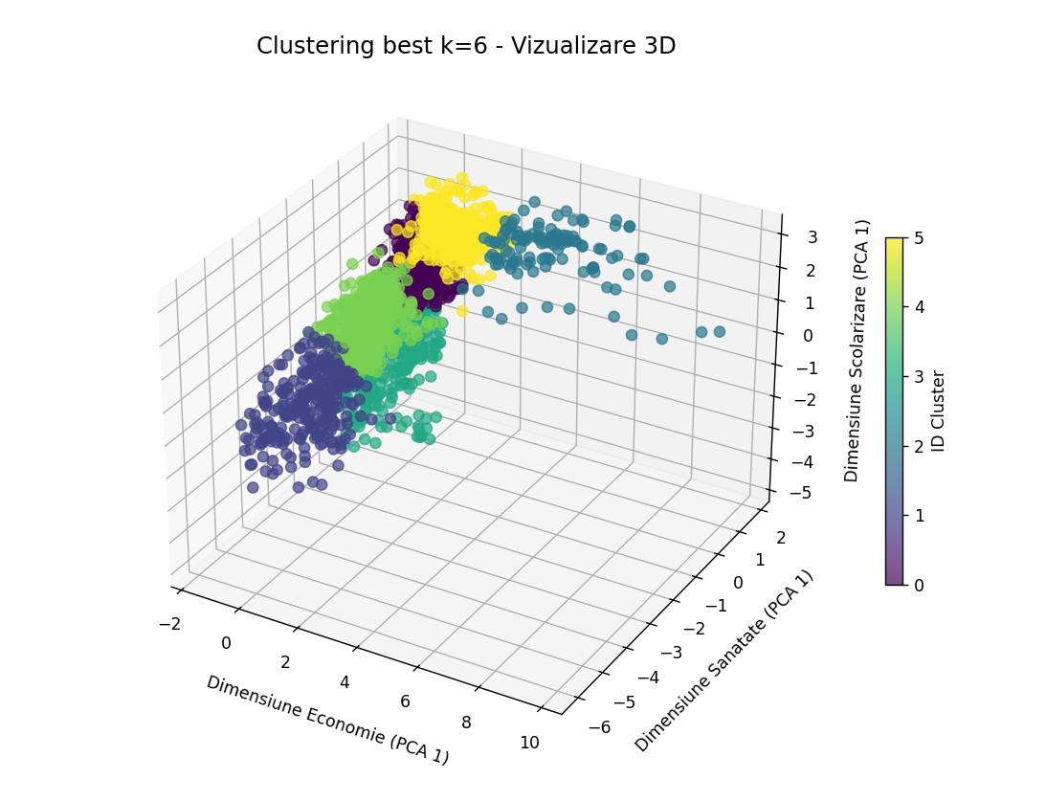
Clustering

Slide 23
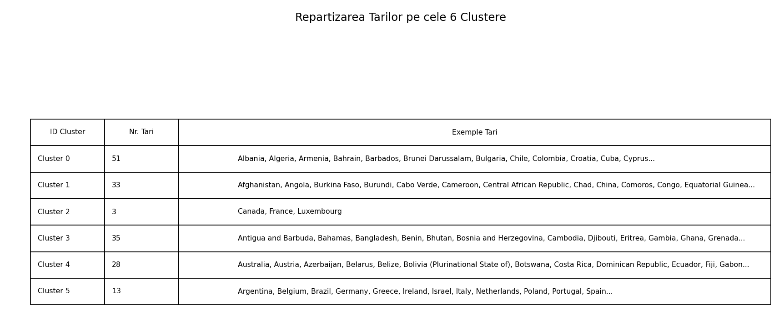
Clustering

Slide 24
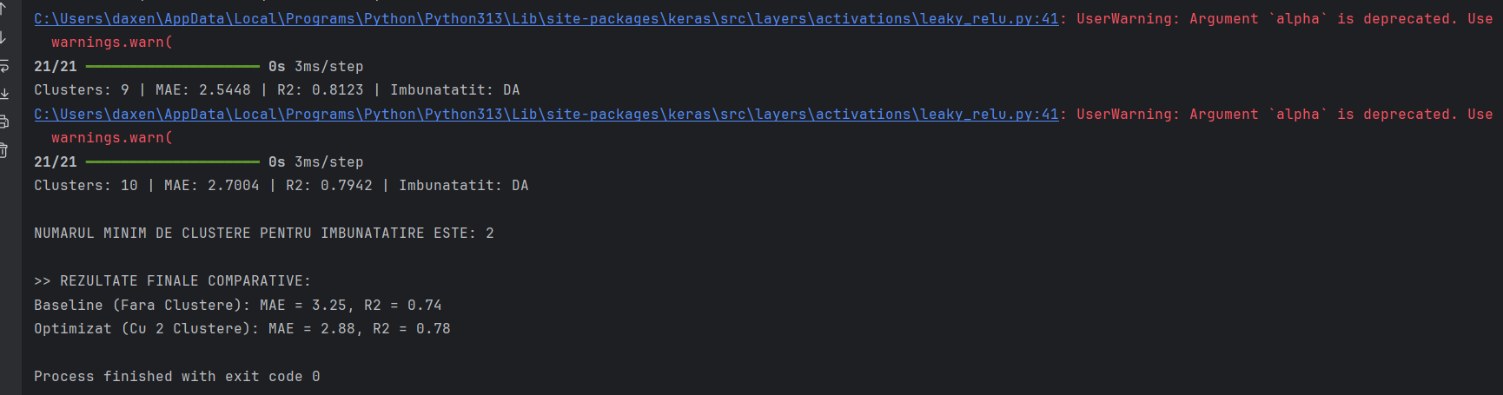
Clustering

Slide 25
Clustering
Concluzii
Utilizarea clusteringului duce de fiecare data la o performata mai scazuta, datorita overfittingului
China = outlier masiv pe variabilele "scale-sensitive" - valorile foarte mari ale life expectancy pentru China apar dintr-o combinatie de efecte structurale din date si model: Population extrem de mare, GDP total foarte mare, valori mari/atipice la Measles, under-five deaths, BMI, etc.; cu utilizarea `StandardScaler`, problema ramane; fix:
log1p pe:
Population
GDP
Measles
under-five deaths
sau RobustScaler in loc de StandardScaler
Sau atributul ‘Country’ embedded
Sau utilizarea XGBOOST (XGBoost „inchide" China intr-o zona sigura a datasetului, MLP incearca sa extrapoleze continuu si explodeaza)

Slide 26
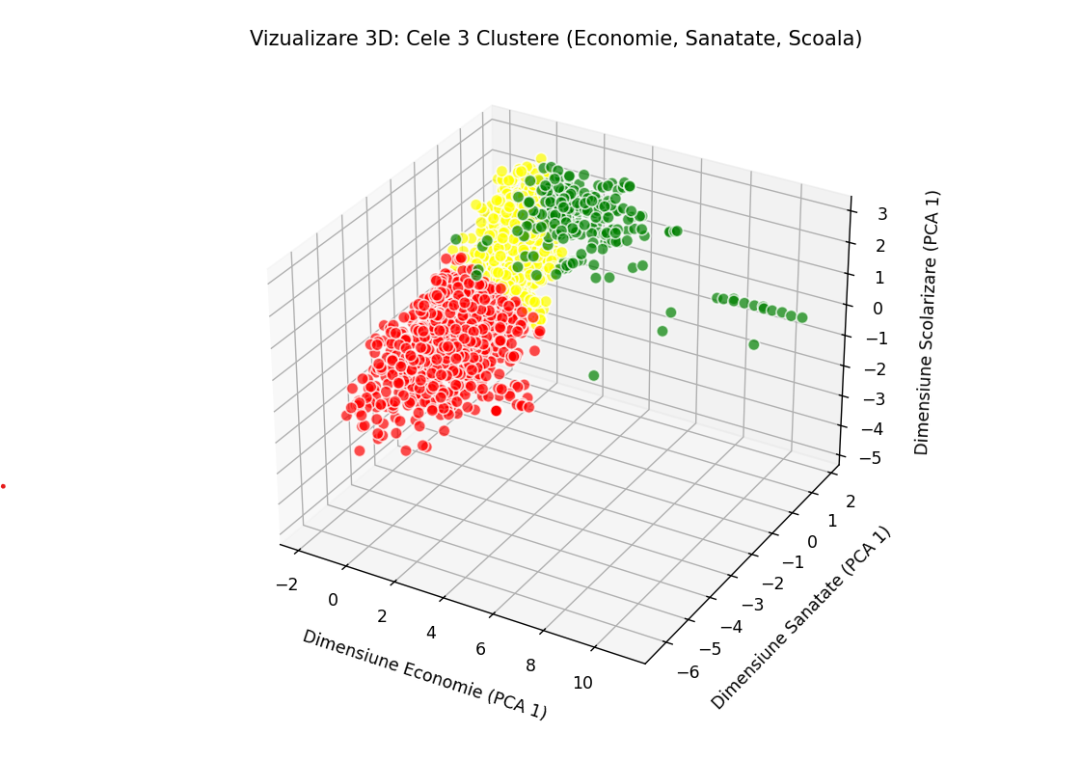
Clustering
Economie= ['GDP', 'percentage expenditure', 'Total expenditure’] Sanatate = ['BMI', 'under-five deaths', 'Hepatitis B', 'Diphtheria', 'HIV/AIDS', 'Polio’] Scolarizare= ['Schooling', 'Income composition of resources']

Slide 27
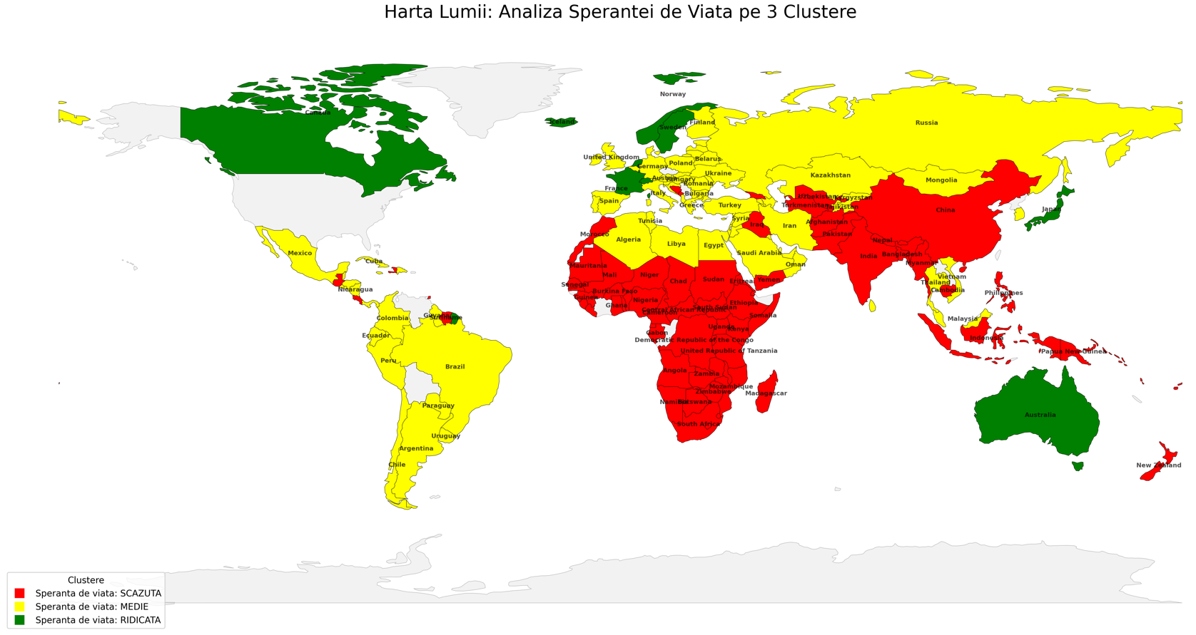
Clustering

Slide 28
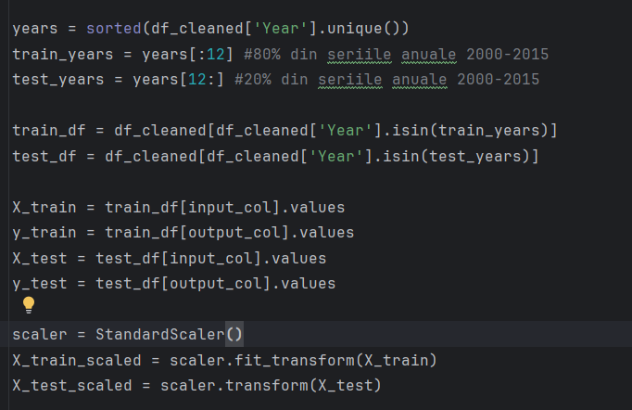
B. X_train vs X_test

Slide 29
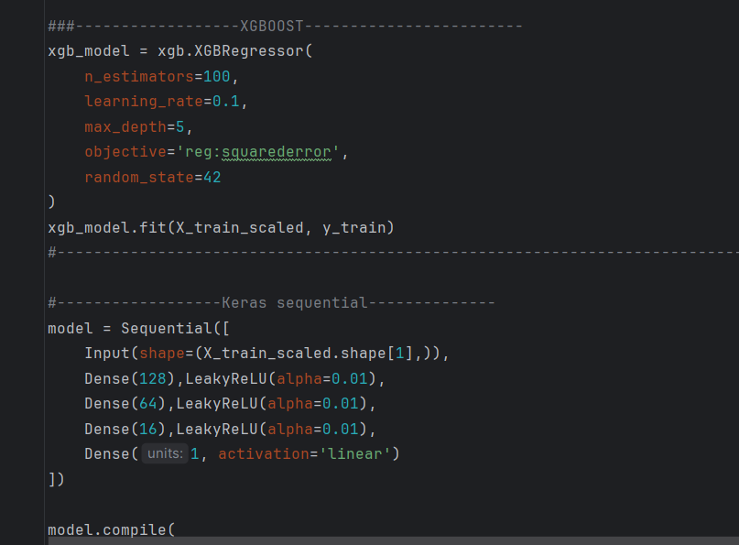
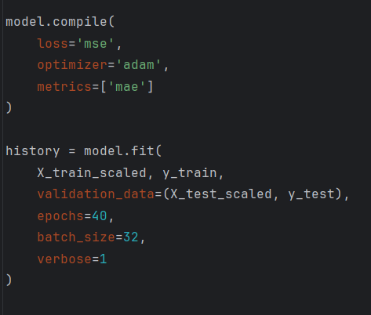
B. XGBoost vs Keras MLP

Slide 30
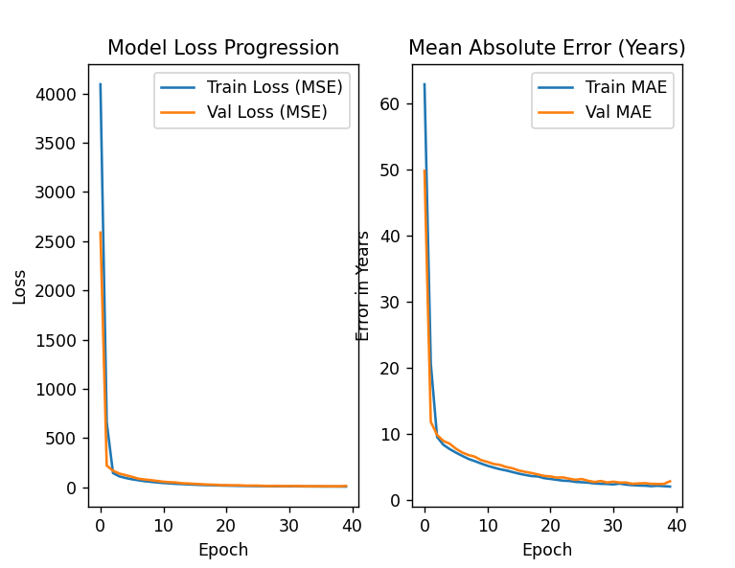
B. XGBoost vs Keras MLP

Slide 31
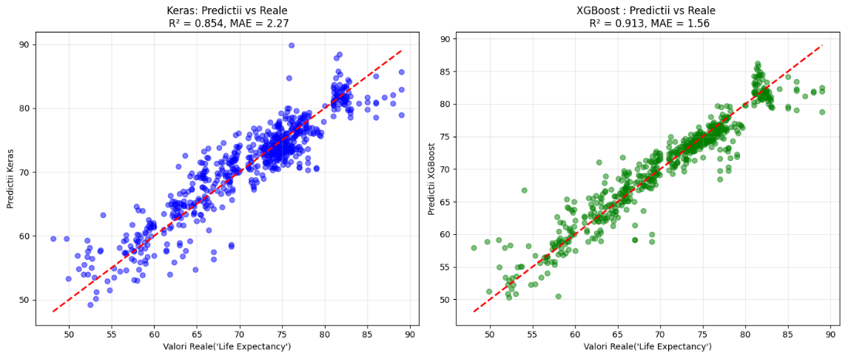
XGBoost vs Keras MLP
Keras vs XGBoost valorii reale si predictii

Slide 32
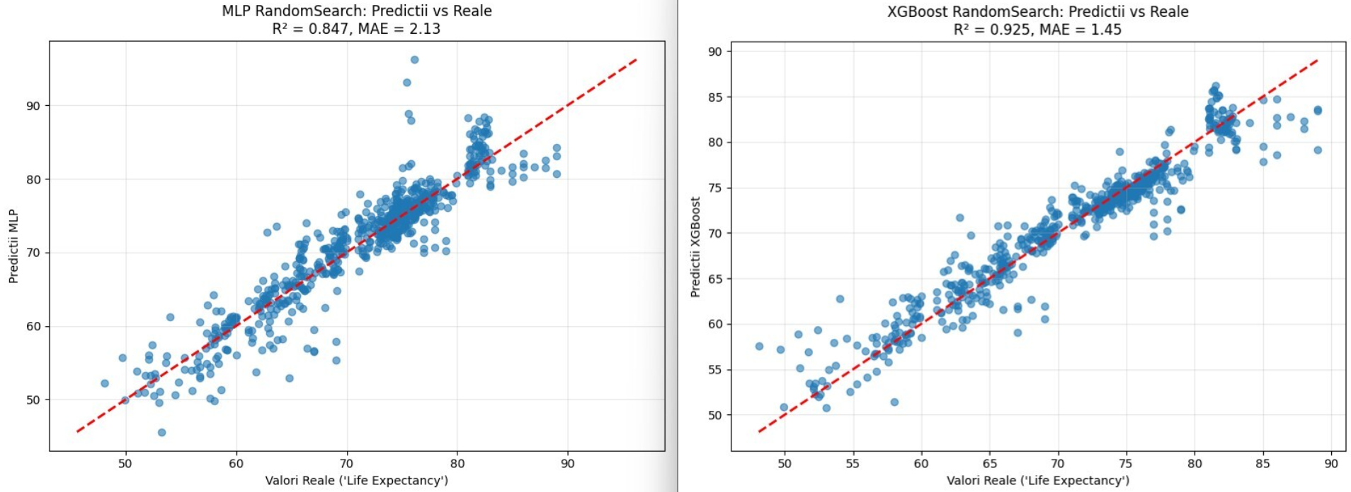
XGBoost vs Keras MLP

Slide 33
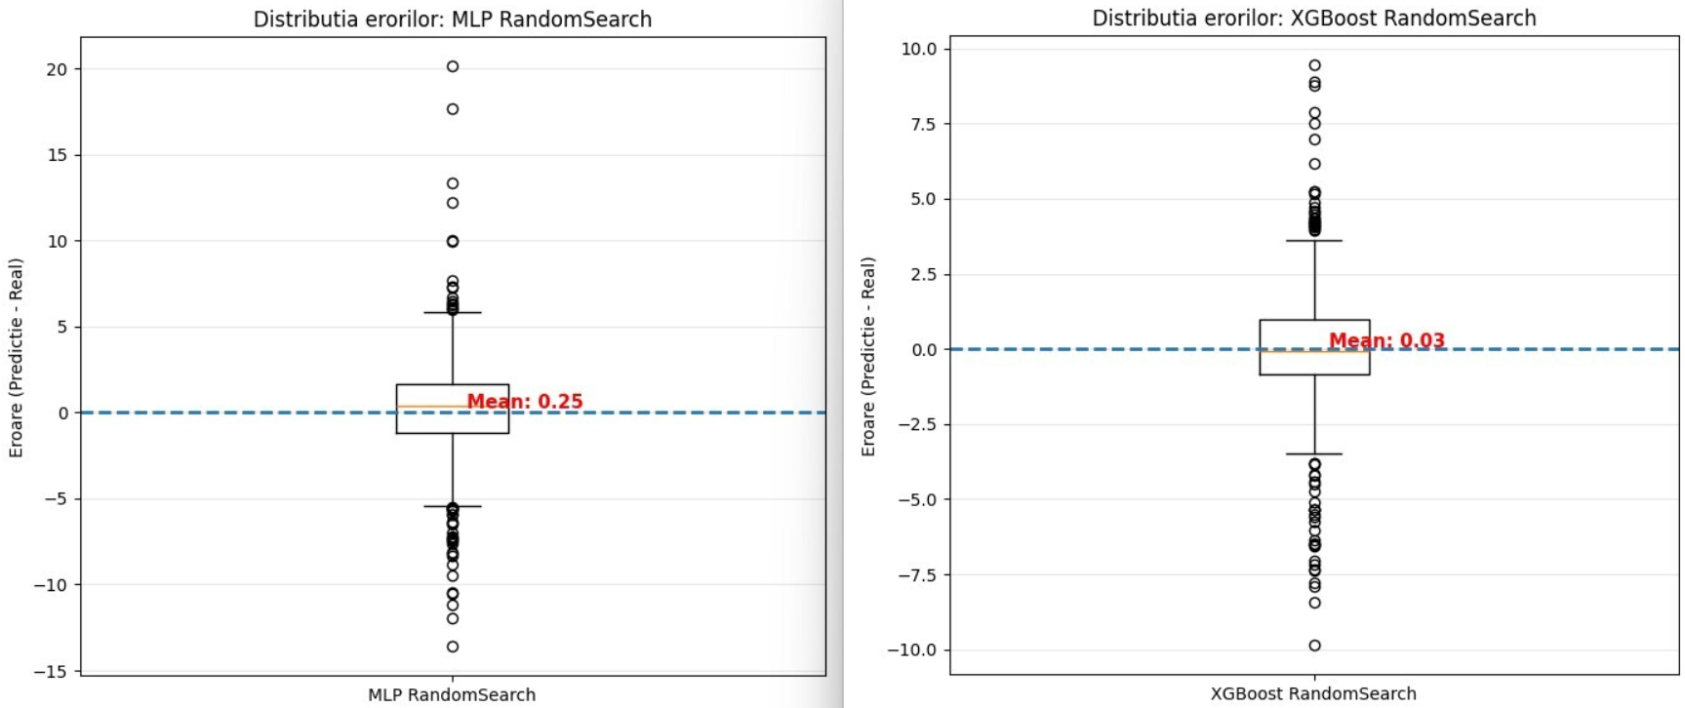
XGBoost vs Keras MLP

Slide 34
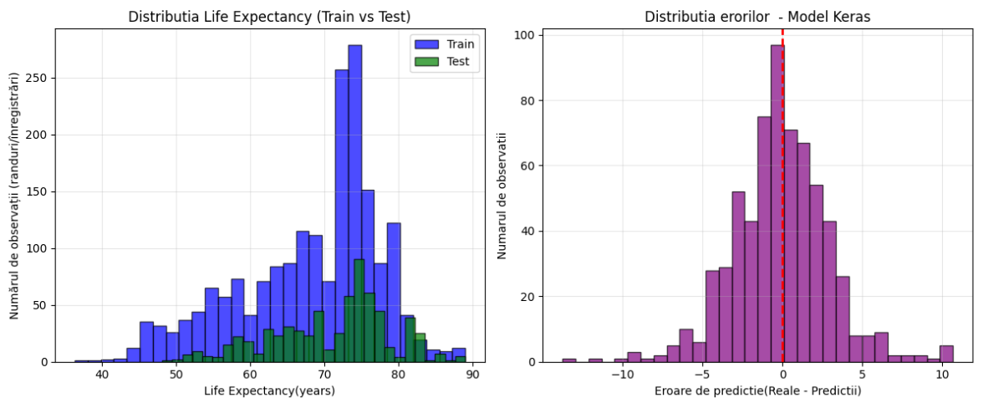
XGBoost vs Keras MLP

Slide 35
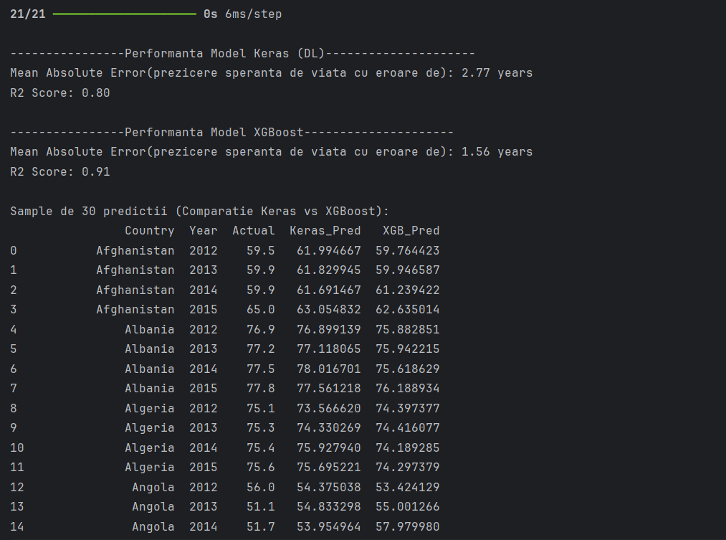
B. XGBoost vs Keras MLP

Slide 36
B. XGBoost vs Keras MLP
Sample de 30 predictii (Comparatie Keras vs XGBoost):
 | Country | Year | Actual | Keras_Pred | XGB_Pred
 | Afghanistan | 2012 | 59.5 | 61.994667 | 59.764423
 | Afghanistan | 2013 | 59.9 | 61.829945 | 59.946587
 | Afghanistan | 2014 | 59.9 | 61.691467 | 61.239422
 | Afghanistan | 2015 | 65 | 63.054832 | 62.635014
 | Albania | 2012 | 76.9 | 76.899139 | 75.882851
 | Albania | 2013 | 77.2 | 77.118065 | 75.942215
 | Albania | 2014 | 77.5 | 78.016701 | 75.618629
 | Albania | 2015 | 77.8 | 77.561218 | 76.188934
 | Algeria | 2012 | 75.1 | 73.56662 | 74.397377
 | Algeria | 2013 | 75.3 | 74.330269 | 74.416077
 | Algeria | 2014 | 75.4 | 75.92794 | 74.189285
 | Algeria | 2015 | 75.6 | 75.695221 | 74.297379
 | Angola | 2012 | 56 | 54.375038 | 53.424129
 | Angola | 2013 | 51.1 | 54.833298 | 55.001266
 | Angola | 2014 | 51.7 | 53.954964 | 57.97998
 | Angola | 2015 | 52.4 | 58.451073 | 58.300034
 | Antigua | 2012 | 75.9 | 74.834038 | 74.357819
 | Antigua | 2013 | 76.1 | 74.928879 | 74.497604
 | Antigua | 2014 | 76.2 | 75.087875 | 74.240723
 | Antigua | 2015 | 76.4 | 77.169426 | 73.973434
 | Argentina | 2012 | 75.9 | 79.943733 | 78.022484
 | Argentina | 2013 | 76 | 78.192574 | 76.647156
 | Argentina | 2014 | 76.2 | 78.29039 | 76.60495
 | Argentina | 2015 | 76.3 | 80.047623 | 77.178337
 | Armenia | 2012 | 74.4 | 75.63356 | 74.92614
 | Armenia | 2013 | 74.4 | 75.747032 | 74.811165
 | Armenia | 2014 | 74.6 | 76.925453 | 74.124008
 | Armenia | 2015 | 74.8 | 76.835487 | 74.940231
 | Australia | 2012 | 82.3 | 84.38591 | 81.844734
 | Australia | 2013 | 82.5 | 84.575218 | 81.844734

Slide 37
B. Modelul XGBoost si Random Search
Algoritm: XGBoost (Gradient Boosting nativ).
Optimizare: Random Search (30 combinatii de parametri).
Early Stopping: Prevenirea overfitting-ului (50 runde).
Hiperparametri: Learning rate (eta), Adancime (max_depth), Subsample, Regularizare (Alpha/Lambda).

Slide 38
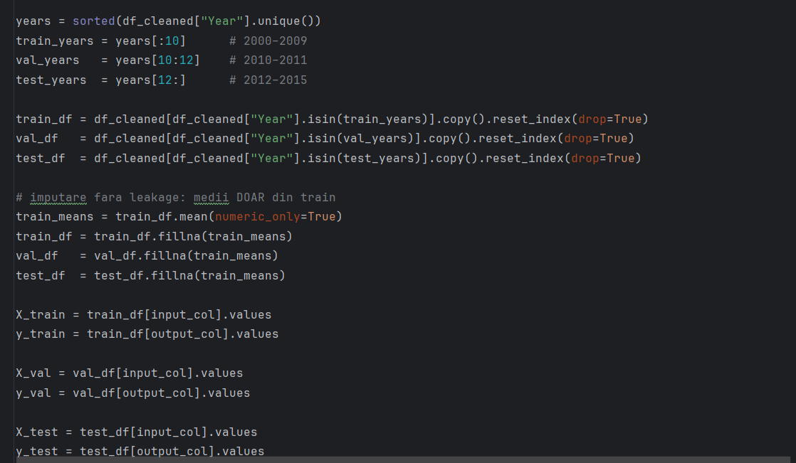
Modelul XGBoost si Random Search

Slide 39
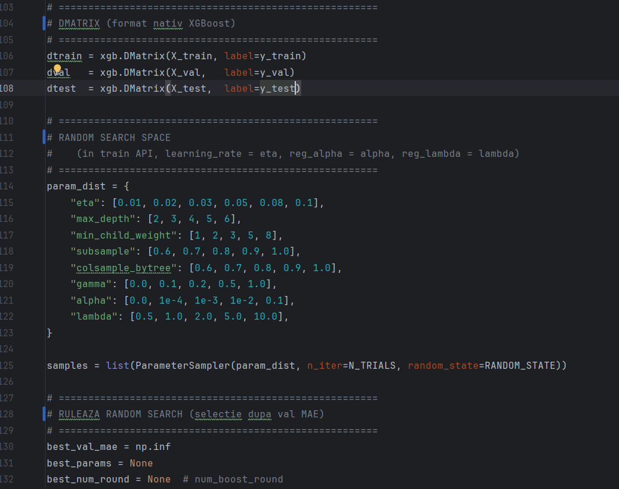
Modelul XGBoost si Random Search

Slide 40
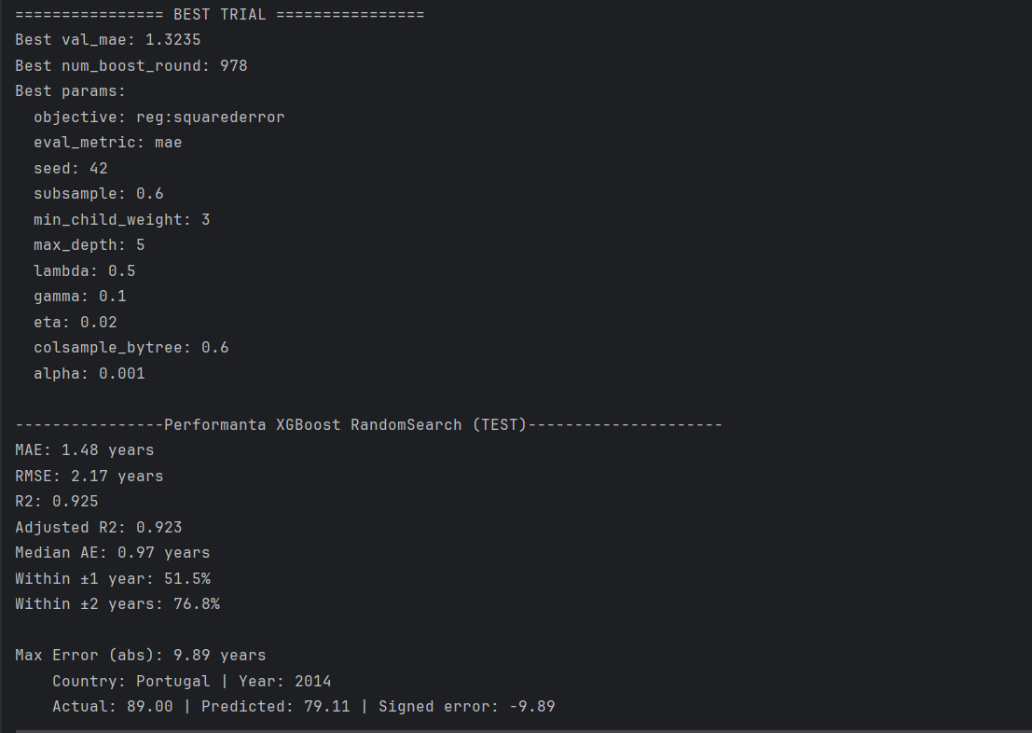
Modelul XGBoost si Random Search

Slide 41
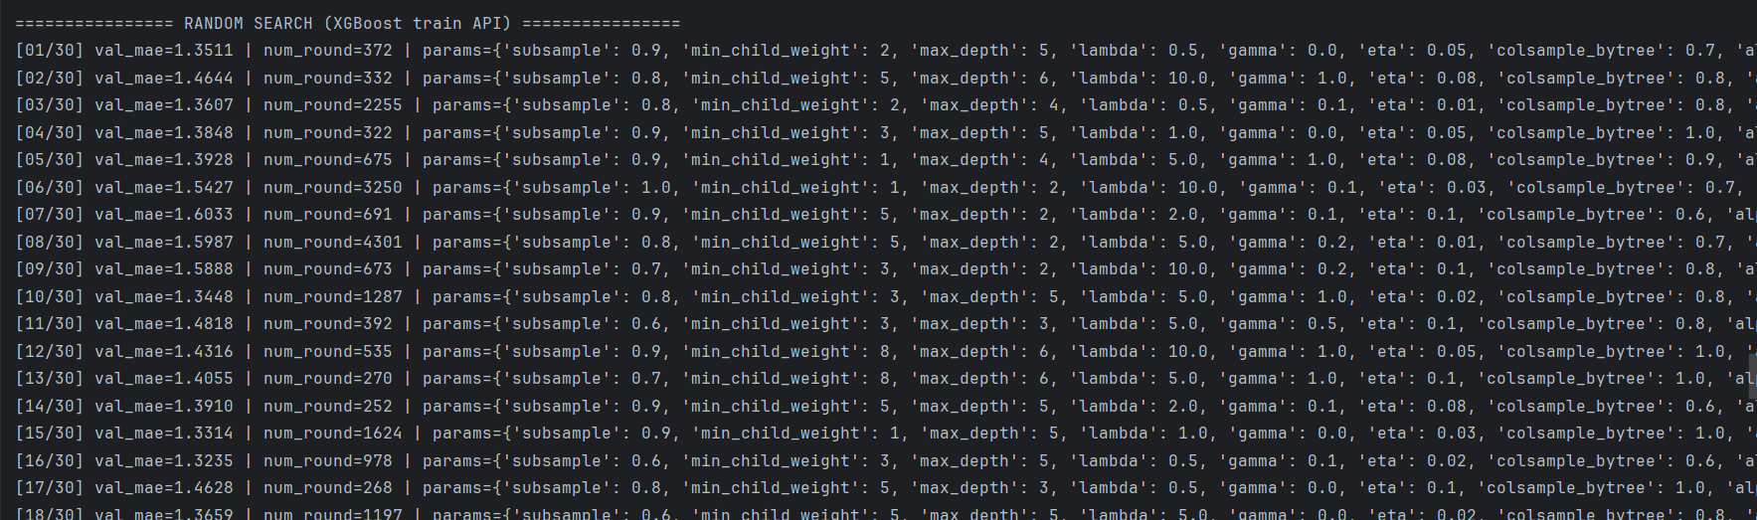
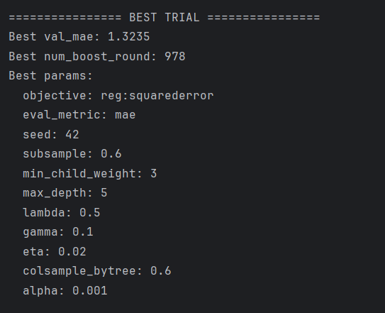
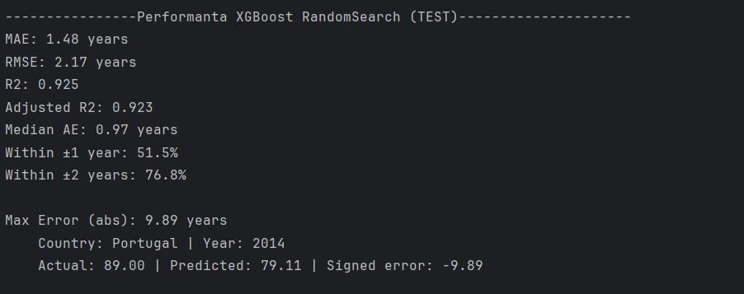
Modelul XGBoost si Random Search

Slide 42
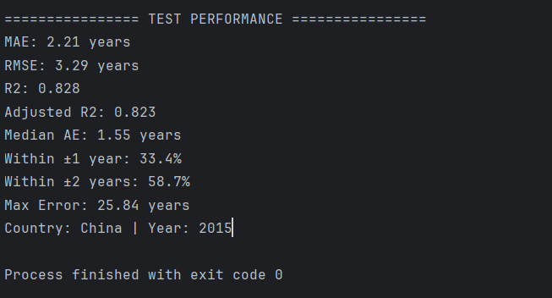
Keras MLP ReLU si Random search

Slide 43
Modelul XGBoost si Random Search
Sample de 30 predictii:
Country | Year | Actual | Predicted | Error | AbsError
Afghanistan | 2012 | 59.5 | 60.261 | 0.760517 | 0.760517
Afghanistan | 2013 | 59.9 | 60.632 | 0.732298 | 0.732298
Afghanistan | 2014 | 59.9 | 60.47 | 0.569597 | 0.569597
Afghanistan | 2015 | 65 | 62.076 | -2.924145 | 2.924145
Albania | 2012 | 76.9 | 75.659 | -1.241164 | 1.241164
Albania | 2013 | 77.2 | 75.785 | -1.415195 | 1.415195
Albania | 2014 | 77.5 | 76.08 | -1.419853 | 1.419853
Albania | 2015 | 77.8 | 76.761 | -1.038693 | 1.038693
Algeria | 2012 | 75.1 | 74.337 | -0.763445 | 0.763445
Algeria | 2013 | 75.3 | 74.339 | -0.960515 | 0.960515
Algeria | 2014 | 75.4 | 74.152 | -1.248228 | 1.248228
Algeria | 2015 | 75.6 | 73.966 | -1.63421 | 1.63421
Angola | 2012 | 56 | 53.899 | -2.101494 | 2.101494
Angola | 2013 | 51.1 | 55.801 | 4.701113 | 4.701113
Angola | 2014 | 51.7 | 57.204 | 5.503899 | 5.503899
Angola | 2015 | 52.4 | 58.624 | 6.223989 | 6.223989
Antigua | 2012 | 75.9 | 74.878 | -1.021964 | 1.021964
Antigua | 2013 | 76.1 | 75.061 | -1.03927 | 1.03927
Antigua | 2014 | 76.2 | 74.836 | -1.364429 | 1.364429
Antigua | 2015 | 76.4 | 74.293 | -2.10665 | 2.10665
Argentina | 2012 | 75.9 | 76.679 | 0.779344 | 0.779344
Argentina | 2013 | 76 | 76.928 | 0.928093 | 0.928093
Argentina | 2014 | 76.2 | 76.788 | 0.58775 | 0.58775
Argentina | 2015 | 76.3 | 77.116 | 0.81631 | 0.81631
Armenia | 2012 | 74.4 | 74.756 | 0.355684 | 0.355684
Armenia | 2013 | 74.4 | 74.715 | 0.314928 | 0.314928
Armenia | 2014 | 74.6 | 74.509 | -0.09099 | 0.09099
Armenia | 2015 | 74.8 | 74.843 | 0.043376 | 0.043376
Australia | 2012 | 82.3 | 81.935 | -0.365147 | 0.365147
Australia | 2013 | 82.5 | 82.254 | -0.245514 | 0.245514

Slide 44
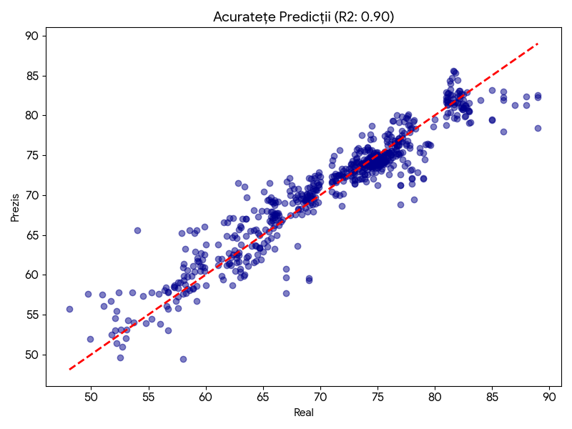
Performanta Modelului (Test Set)
Mean Absolute Error (MAE): 1.78 ani.
R-squared (R2): 0.899.
Semnificatie: Modelul explica peste 90% din variatia datelor.
Eroarea maxima a fost analizata individual pentru identificarea anomaliilor.

Slide 45
Concluzii si Recomandari
Modelul este extrem de robust pe date noi.
Indicatorii de sanatate (HIV, mortalitate) sunt mai predictivi decat cei economici in anumite regiuni.
HIV/AIDS: Impact major negativ asupra longevitatii.
Mortalitate Adulti: Corelatie directa puternica.
Resurse (Income composition): Indicator economic cheie.
Educatie (Schooling): Factor social determinant.
Curatarea riguroasa a datelor a fost esentiala pentru succesul algoritmului.
Rezultate predictive
MAE: 1.48 years
RMSE: 2.17 years
R2: 0.925
Adjusted R2: 0.923
Median AE: 0.97 years
Within ±1 year: 51.5%
Within ±2 years: 76.8%
Max Error (abs): 9.89 years
Country: Portugal | Year: 2014
Actual: 89.00 | Predicted: 79.11 | Signed error: -9.89

